Slide 1
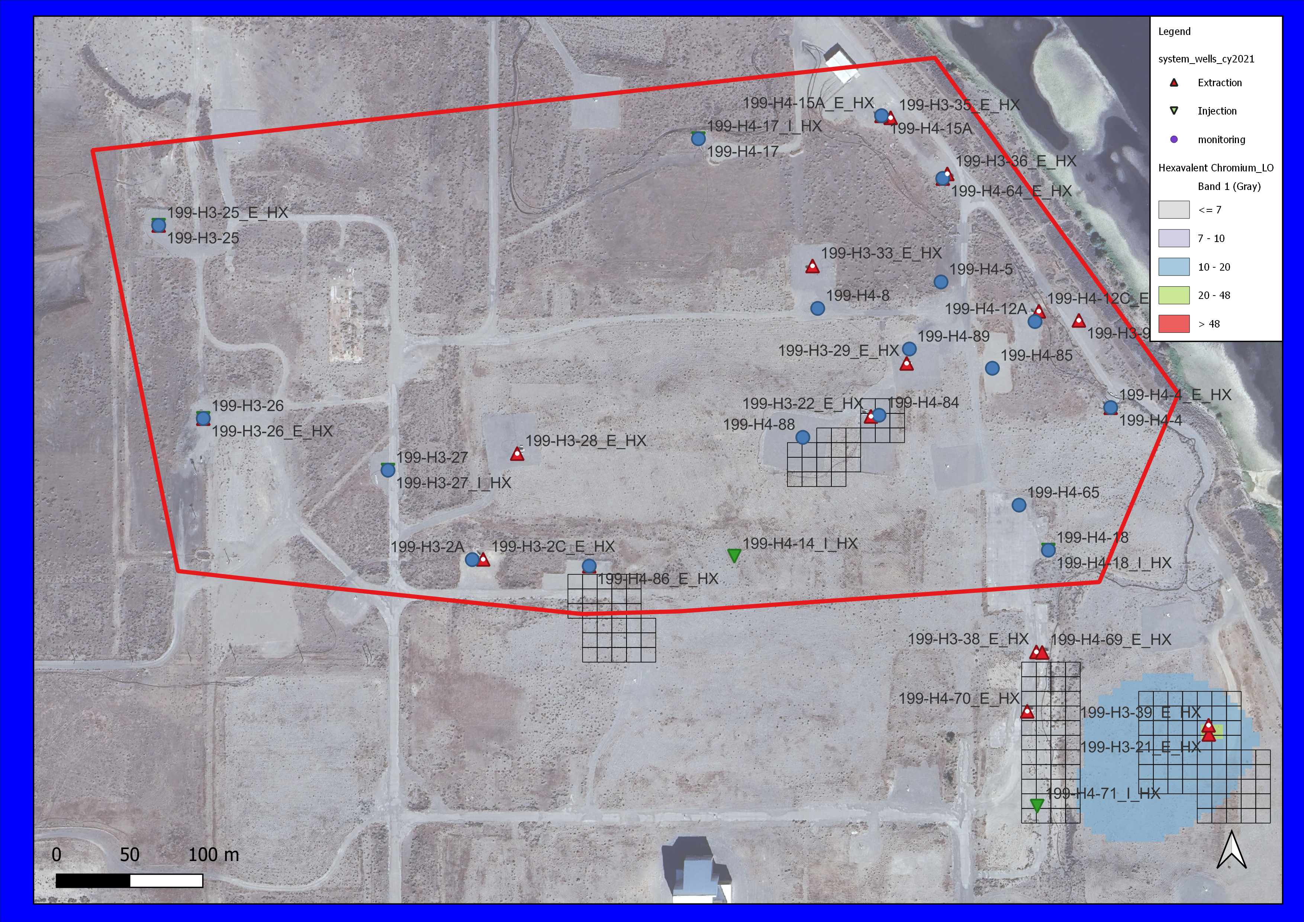
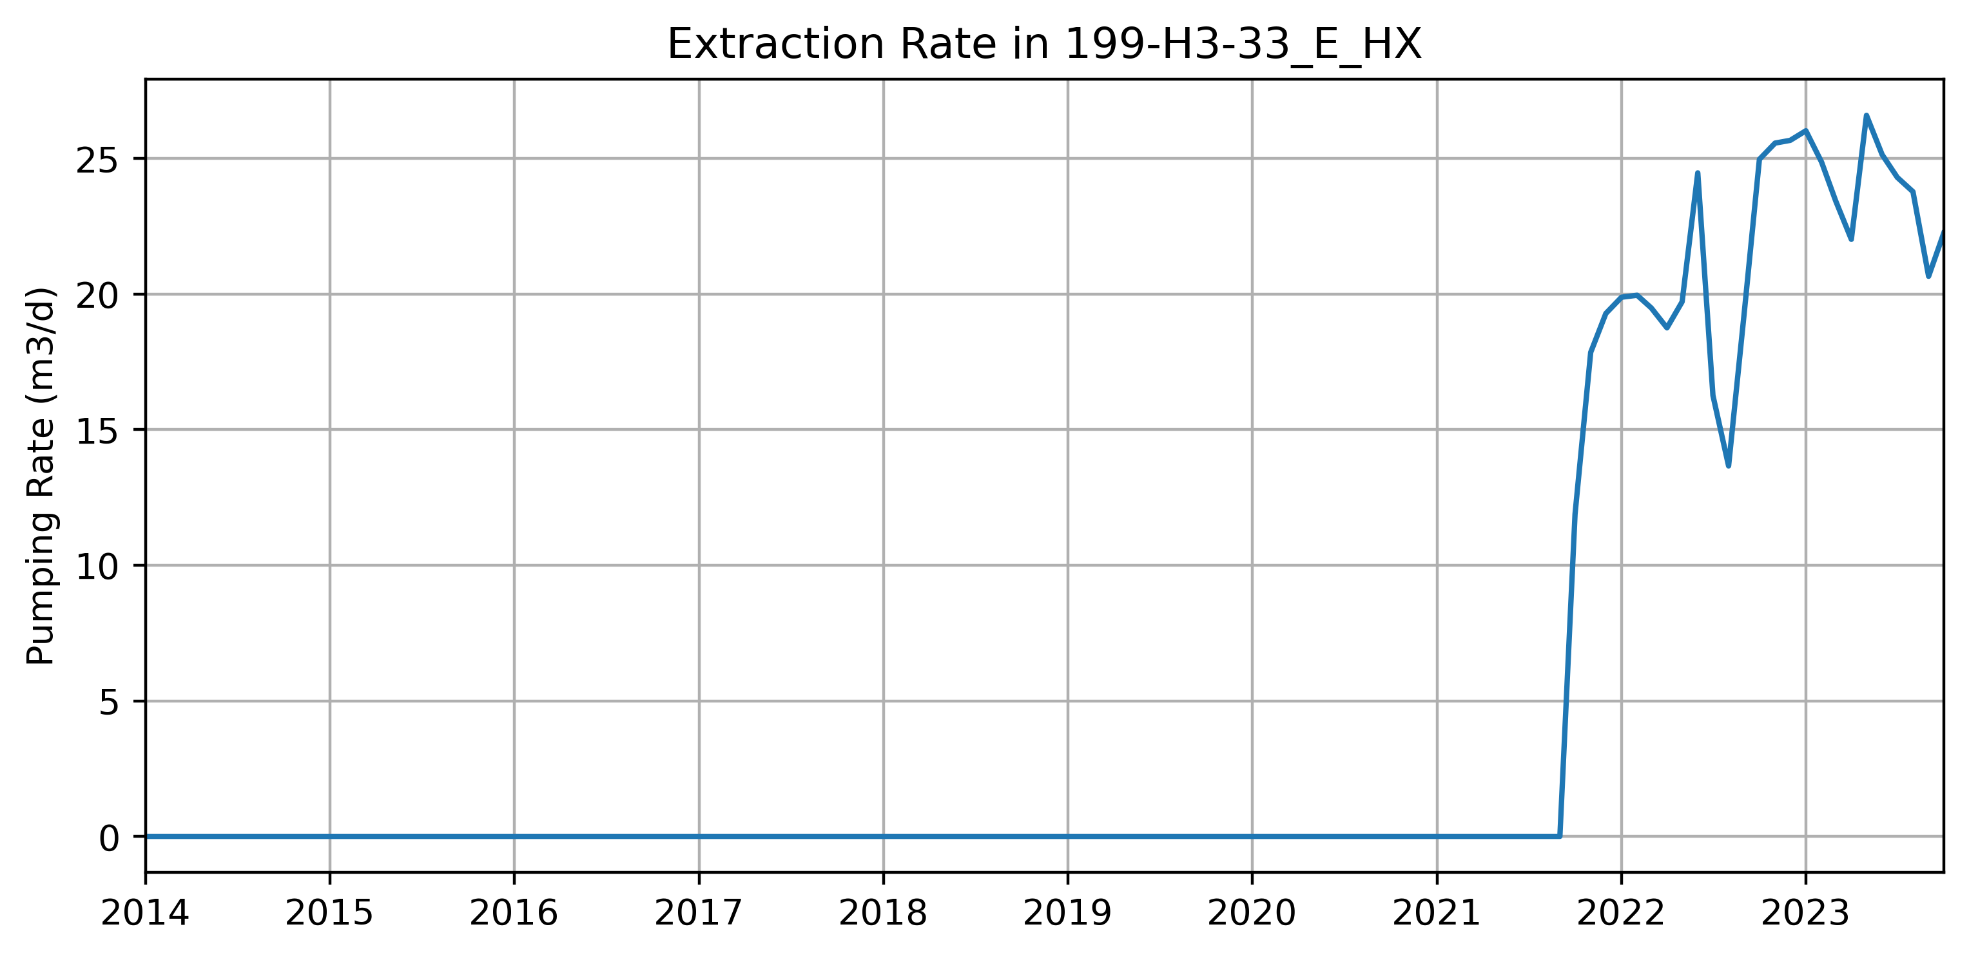
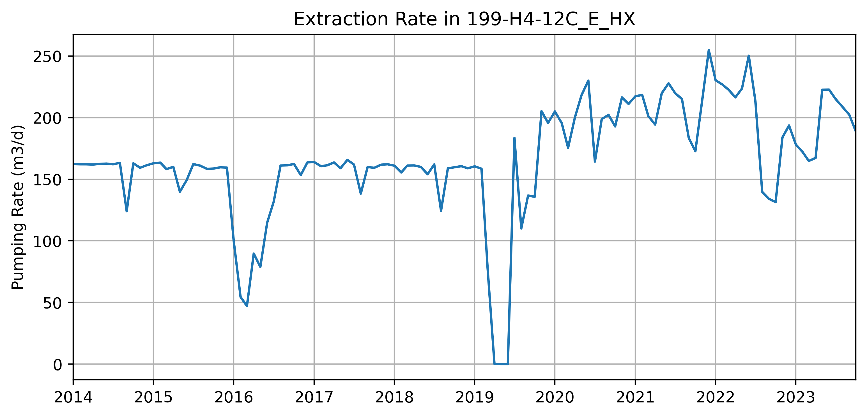
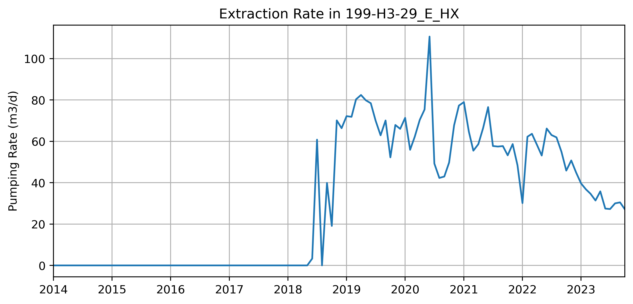
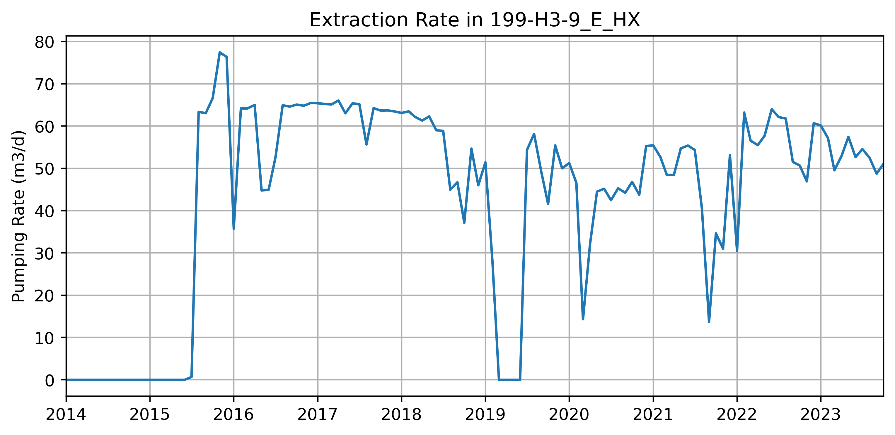
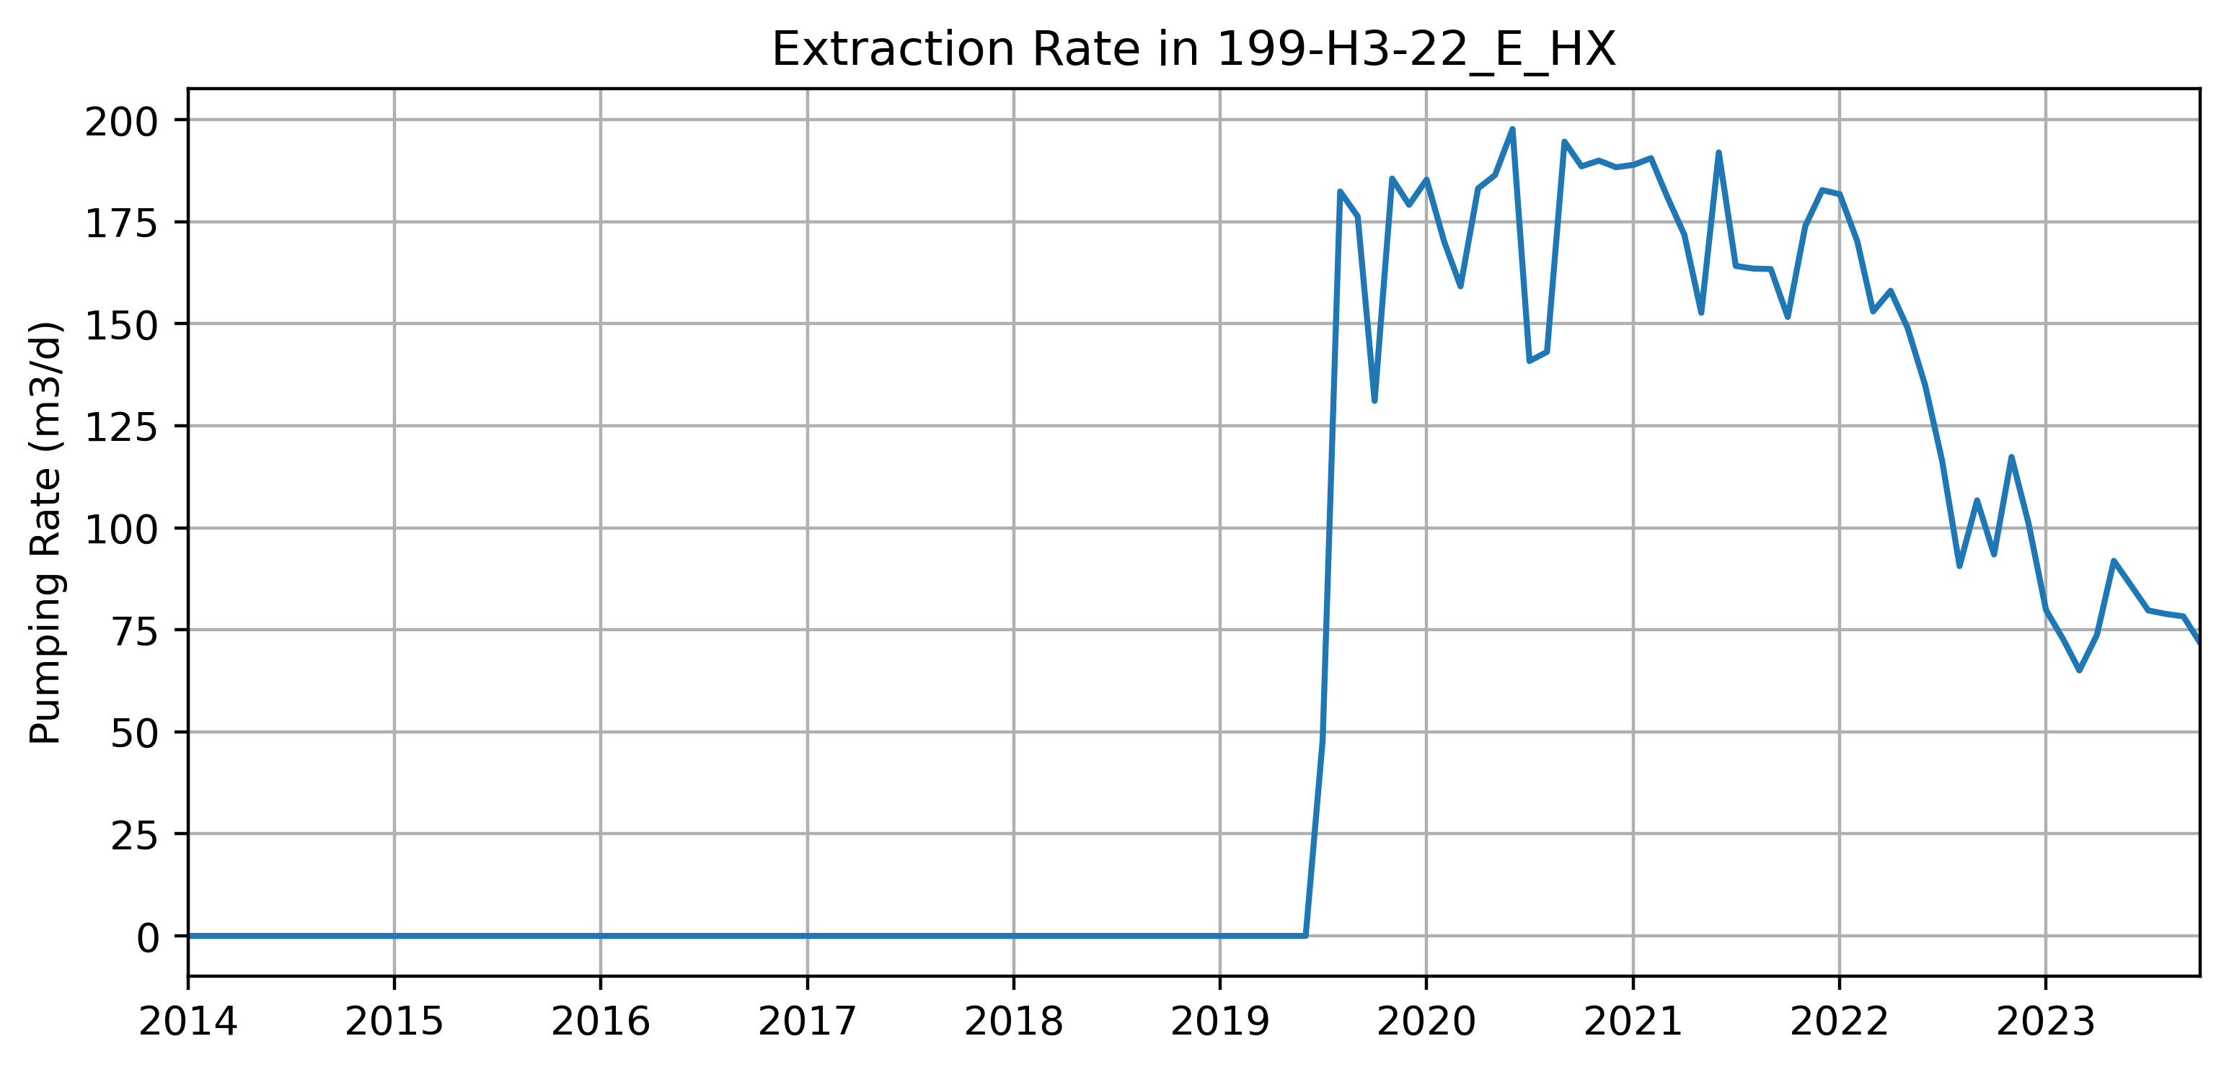
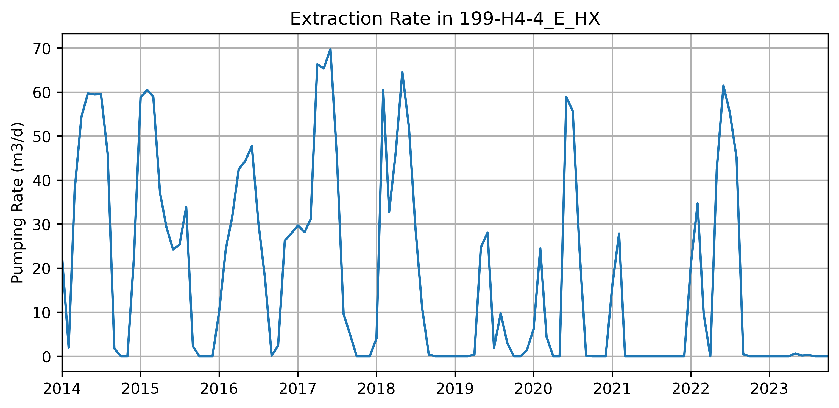
DRAFT SLIDE – we need to show pumping
RUM-2
RUM-2
RUM-2
RUM-2
RUM-2

Slide 2
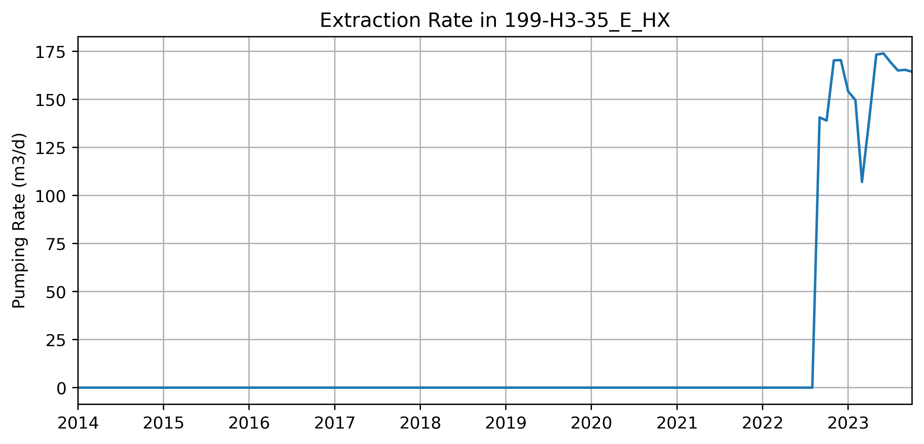
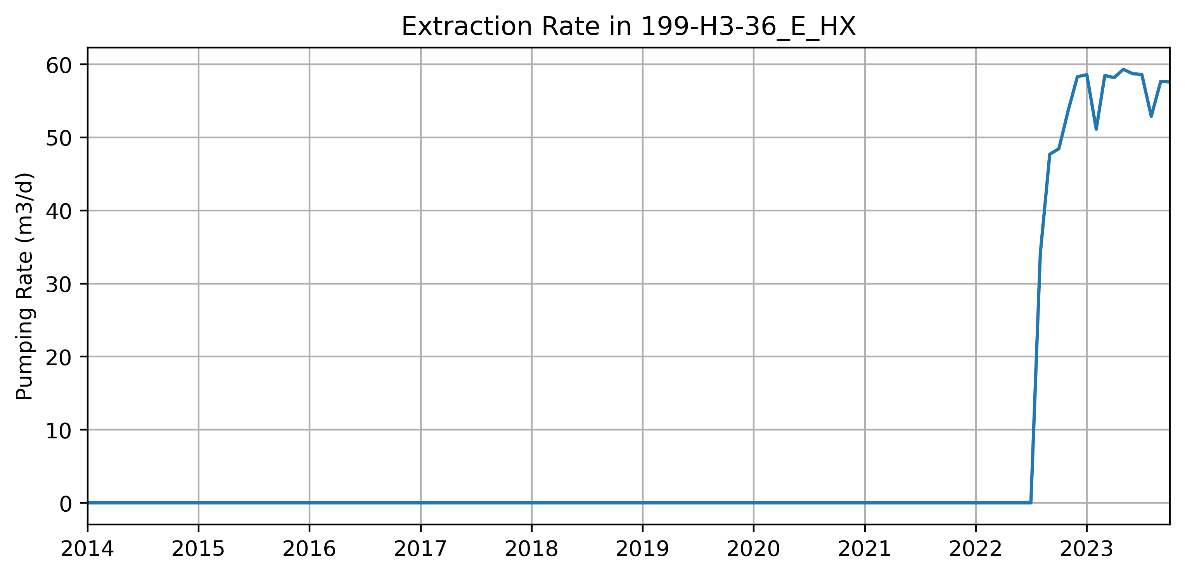
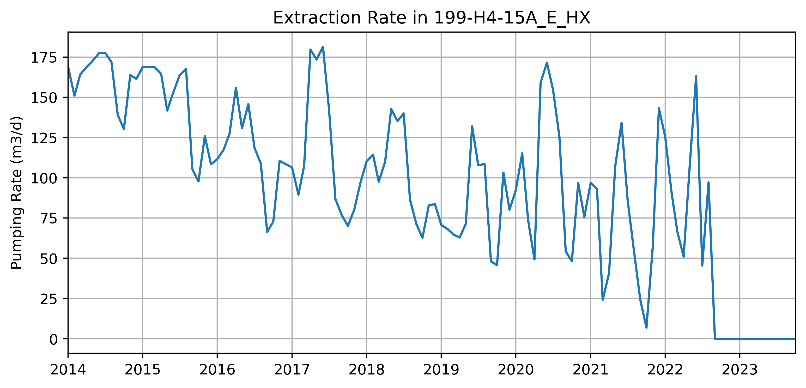
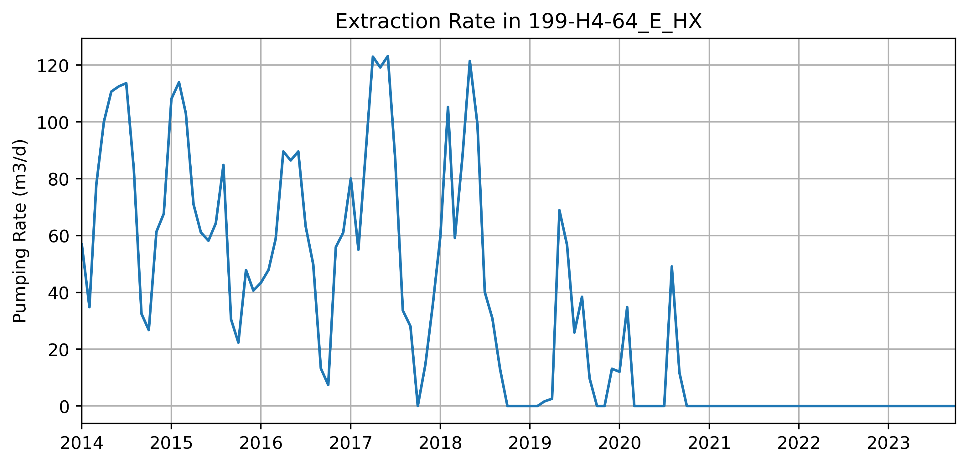
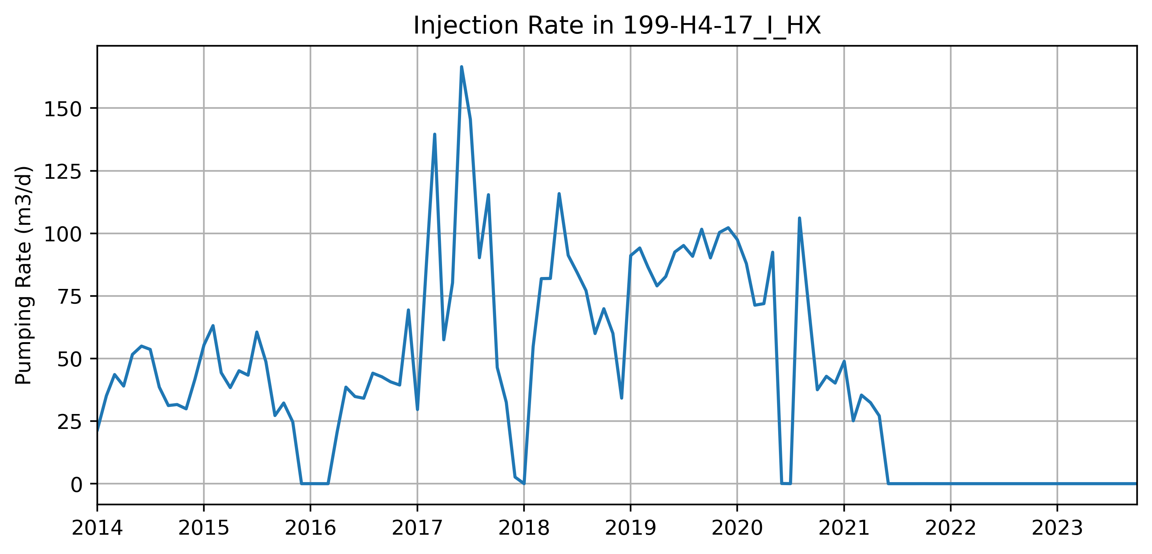
DRAFT SLIDE – we need to show pumping
RUM-2
RUM-2

Slide 3
DRAFT SLIDE – we need to show pumping
Unconfined Wells

Slide 4
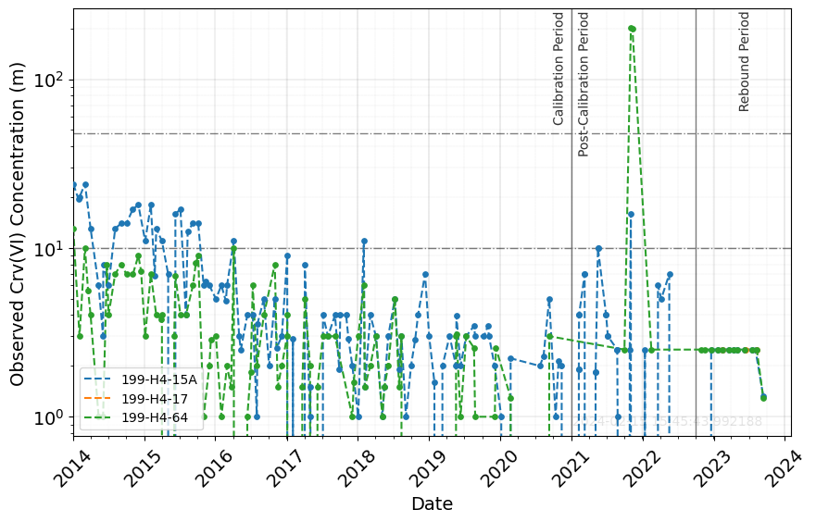
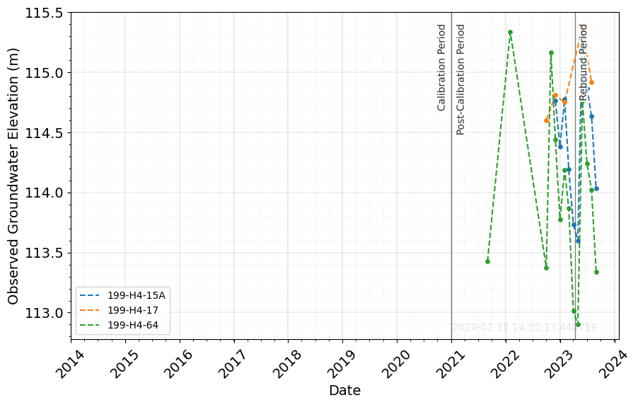
DRAFT SLIDE – we need to show pumping
Unconfined Wells
Peak occurs before rebound study starts, no trend after, sparse WLs, nearby well H4-15A doesn’t show a peak or increase in concentrations during rebound either.

Slide 5
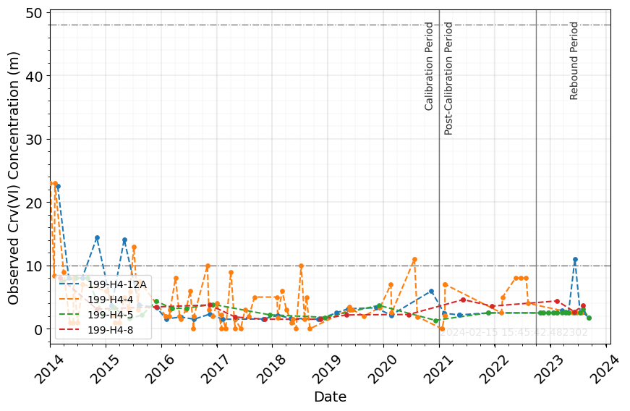
DRAFT SLIDE – we need to show pumping
Unconfined Wells
H4-12A: Small local contaminated soil or plume, fluctuations near river, nearby wells remain less than 10 ug/L, no increasing trend

Slide 6
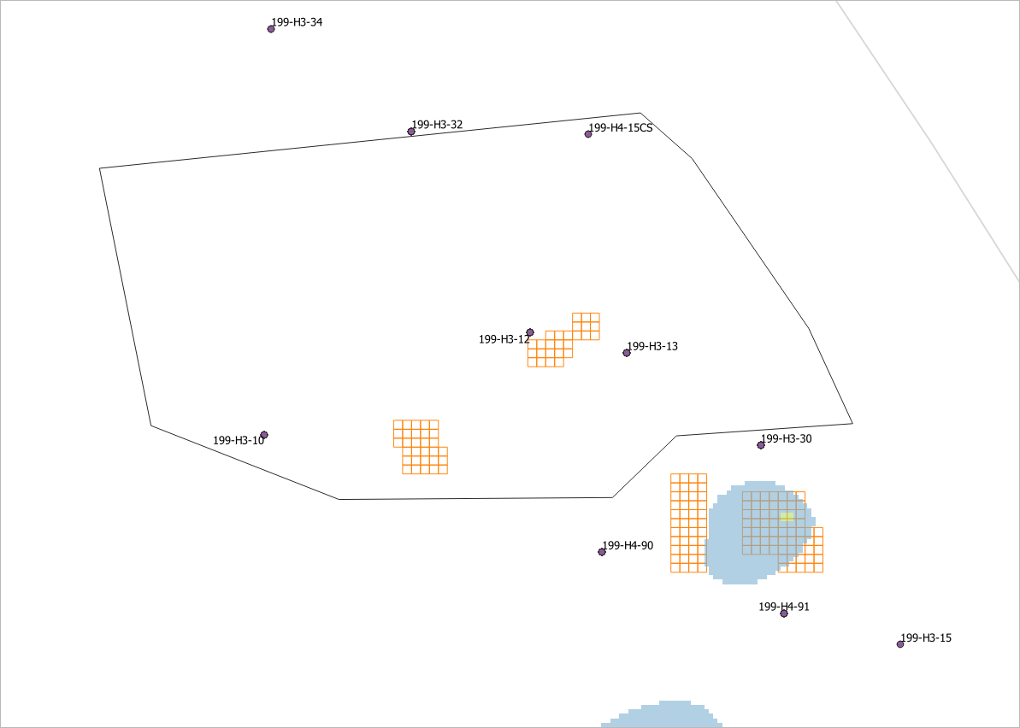
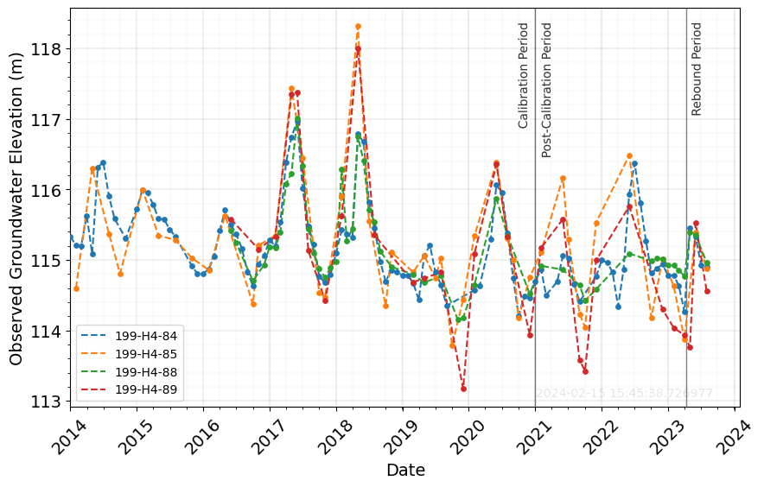
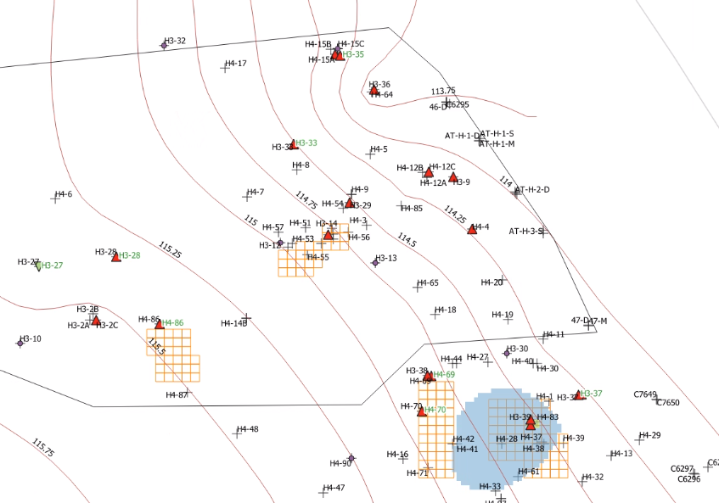
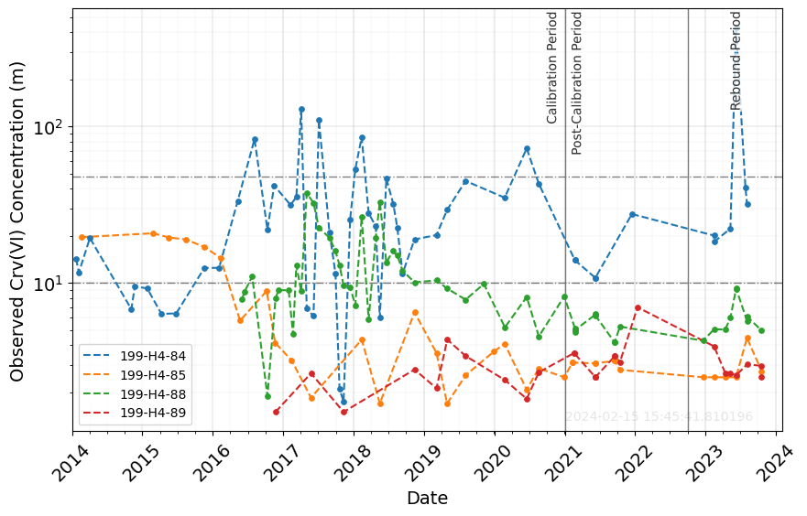
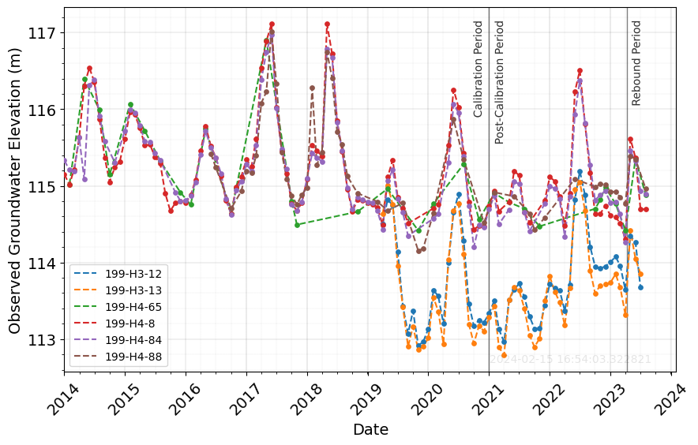
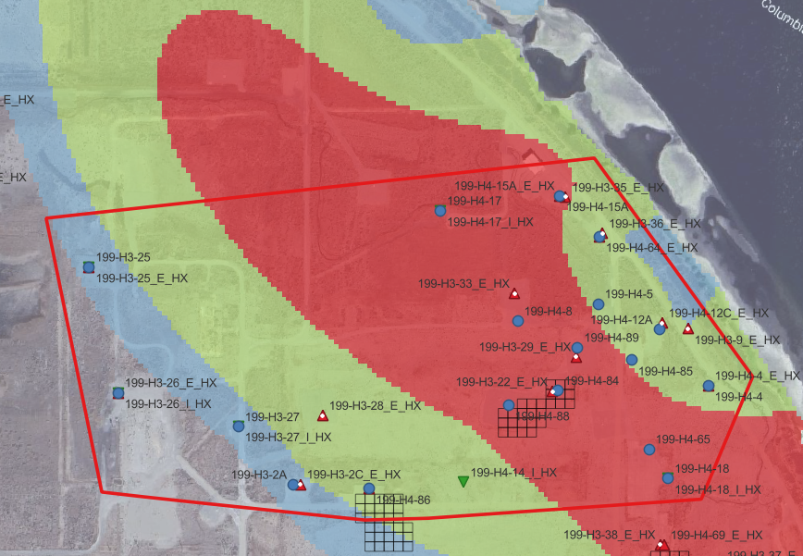
DRAFT SLIDE – we need to show pumping
WL contours unconfined aq – low RS, 2022
No way it’s upward flow
RUM-2 Mapped Plume 2022
RUM-2
RUM-2
H4-84, H4-85 and H4-88 show the SAME PEAK (different magnitude) during REBOUND.
H4-85 is farthest from source, and last to record peak
Extraction in area decreases, leading to higher WLs in RUM, upward flow to unconfined? No recent WL observations for these RUM-2 wells to verify that RUM-2 WL > Unconfined.
Strong correlation with river. We see high WLs before, but no peaks this consistent in concentration. Could be rebound EXT wells shut down, so flow is now NE, not moving towards EXT wells north and south of these wells. Now we see how river influences mass released.

Slide 7
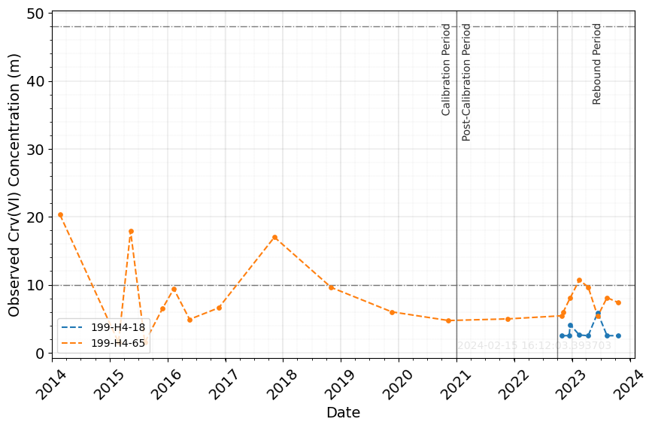
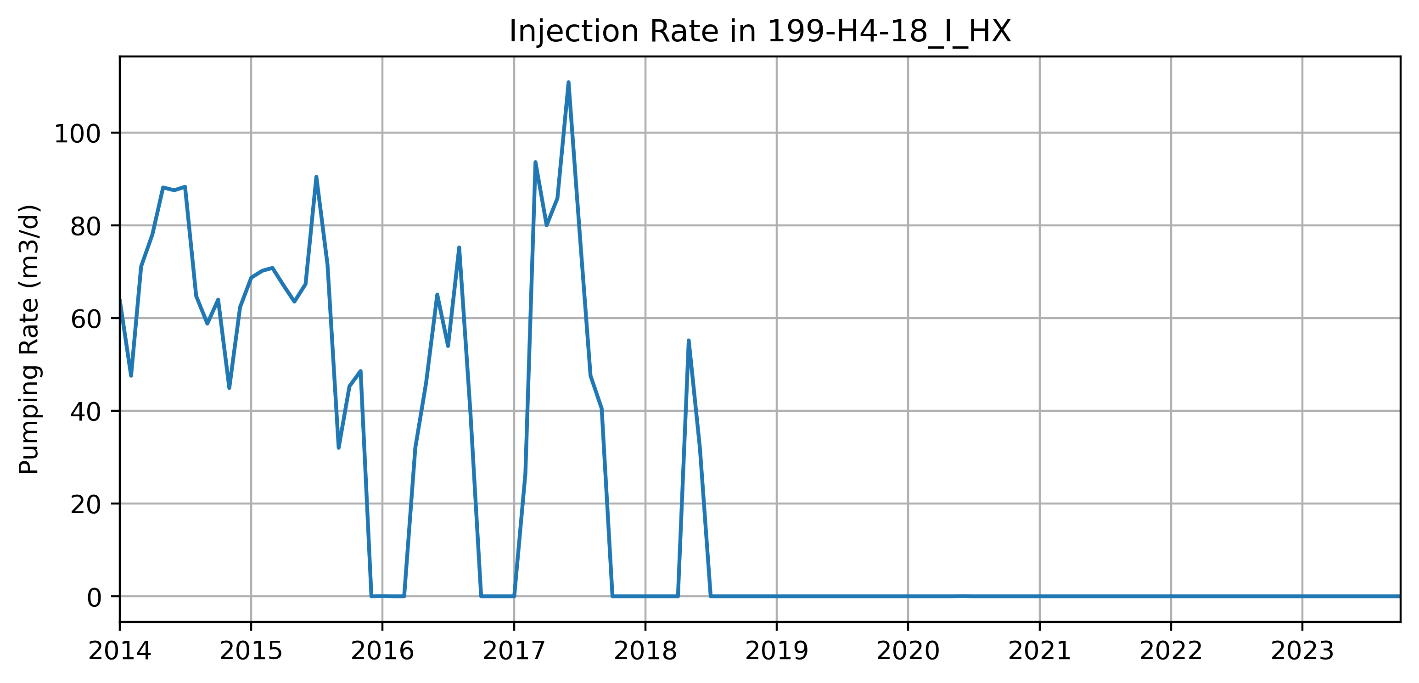
DRAFT SLIDE – we need to show pumping
*Not injecting
Same behavior as other wells
Nearest rebound well impact could be EXT H4-4 stopping, leading to more contamination, but it’s still far?
RUM-2 wwells in H3-22 and H3-29 were strong extraction and decreased significantly rate. This could lead to higher WL in RUM-2 than unconfined, leading to upward flow?

Slide 8
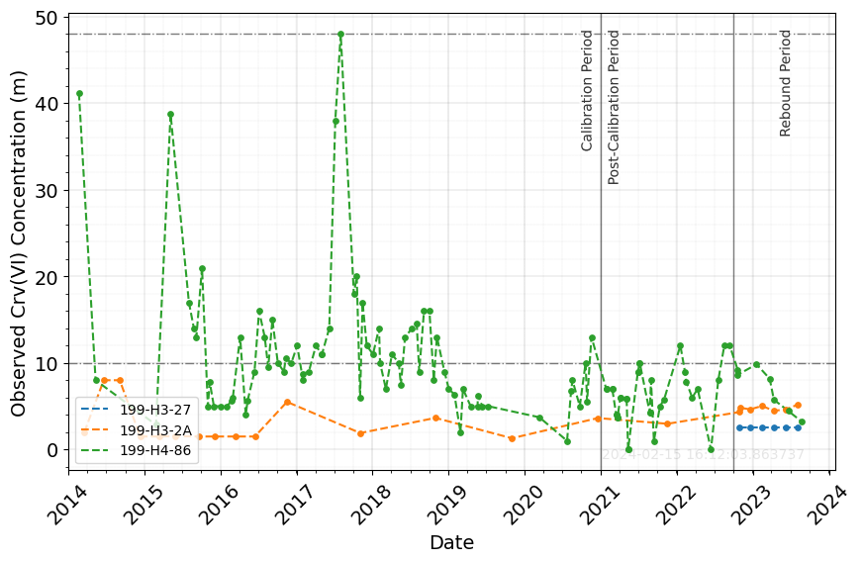
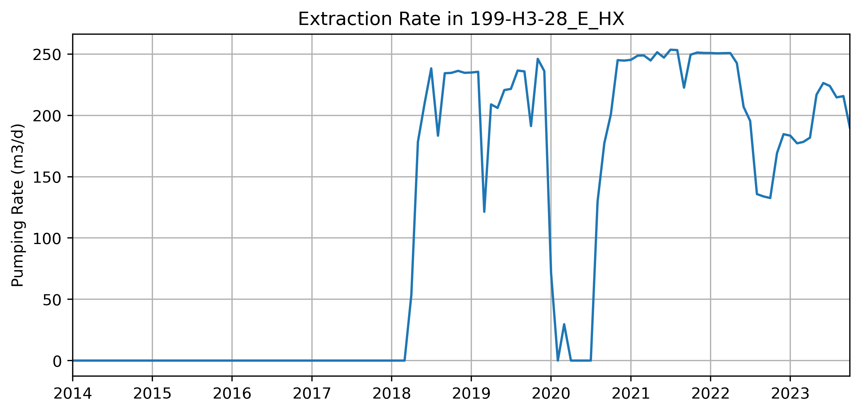
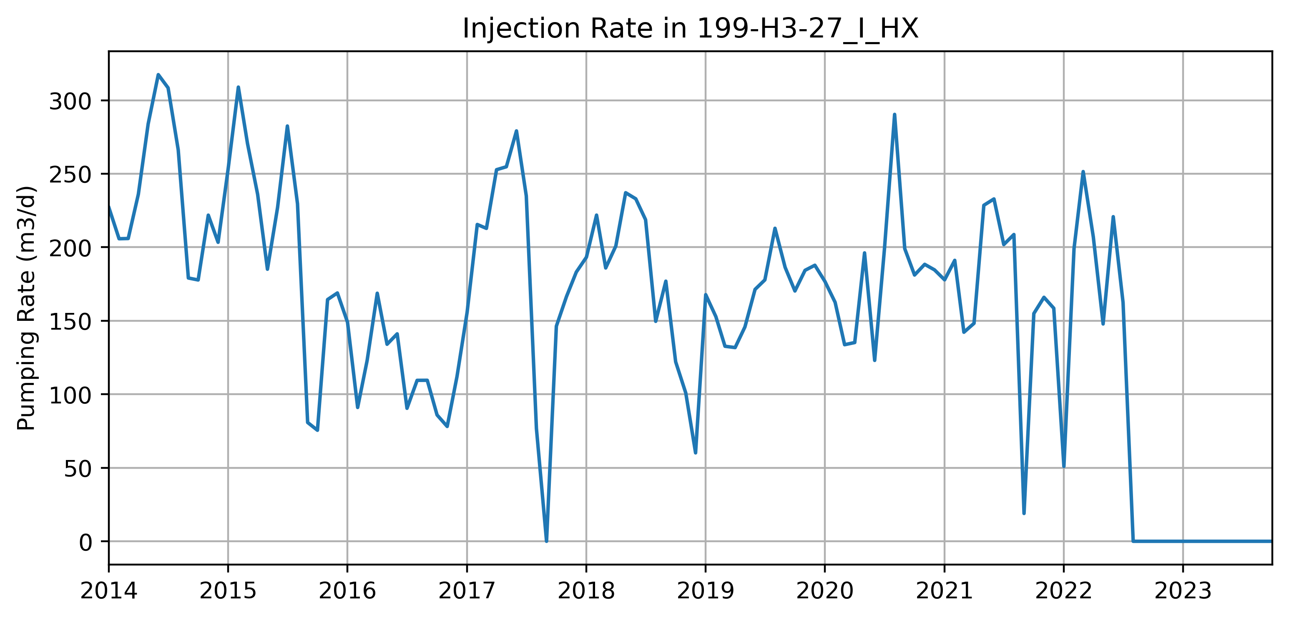
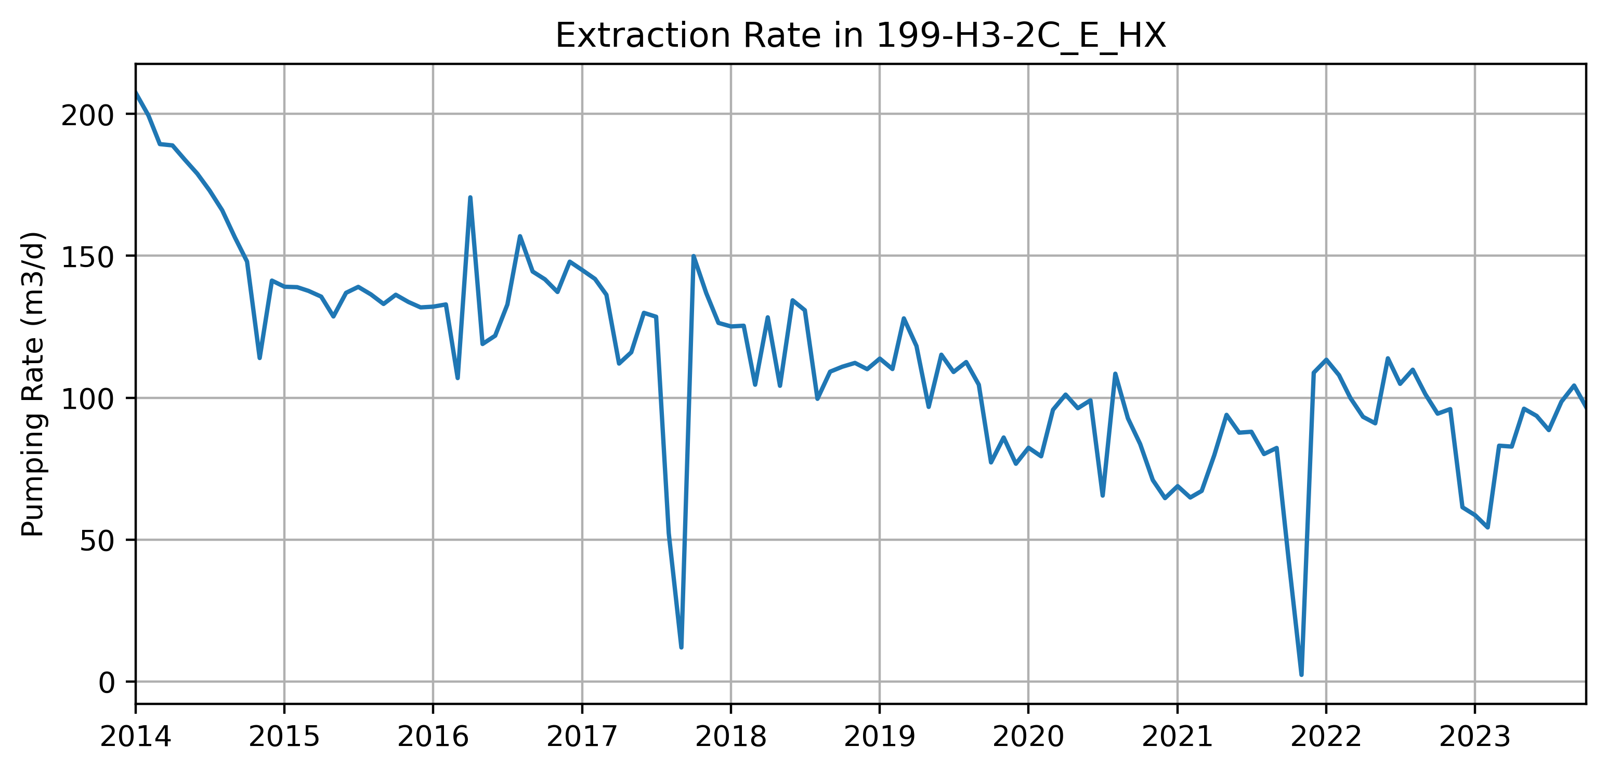
DRAFT SLIDE – we need to show pumping
Decreasing trend or stays below 10 ug/L
RUM-2
RUM-2

